Slide 1


Origins and Status of the OROSHA Variance and Safety Results of Tethered Logging
Dr. John J. Garland, PE
Consulting Forest Engineer
Affiliate Prof. DEOHS, U. Washington
Prof Emeritus, Forest Engineering, Resources, & Management
Oregon State University

Slide 2
Mention of trade names or products does not constitute an endorsement by OROSHA, University of Washington, or Oregon State University. Comments are mine alone and do not represent any organization.

Slide 3
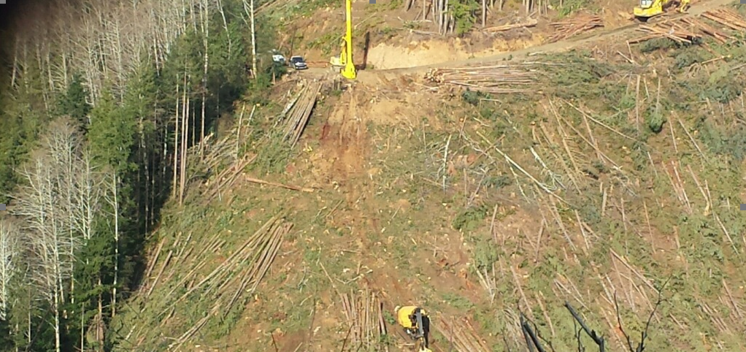
Tethered machines on steep slopes offer exceptional options for safer and productive operations. Why is Oregon different from other states & countries?

Slide 4
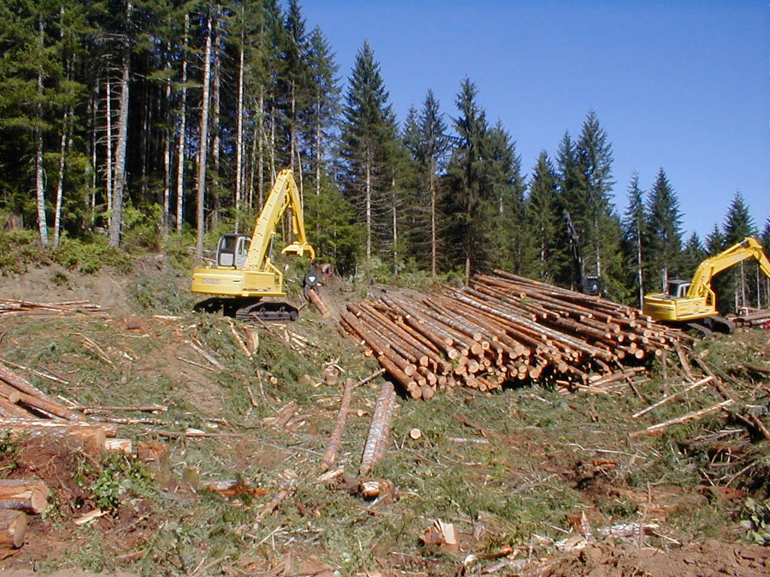
Use of improved hydraulic excavators in 1990’s caused some landowners to push safety limits on contractors doing shovel logging, felling and site preparation. Contractors presented issue to FACC for remedies.
Issue of machine guarding opened up and created tip-over standard for OR now made redundant by international ROPS standard for excavators
ROPS required for tethered machines but lesser guarding allowed for specific conditions in code
Guarding codes stabilized until steep slope machines
Only solution to using system was a research variance w/o code change

Slide 5
437-007-0935 Operation of Ground Skidding Machines and Vehicles.
1. Machines must not be operated on slopes in excess of the following limits unless specified by the manufacturer of the equipment.
(a) Rubber-tired skidders – 30 percent.
(b) Crawler tractors, tracked feller bunchers, tracked excavators and loaders – 40 percent.
(c) Other forestry equipment designed for steep slopes – 50 percent.
2. Operation in excess of the above limits may be permitted for specific limited application or in identified small areas provided the operator and the competent person plan how to safely operate on the steep slopes considering the:
  (a) Experience of the operator.
  (b) Limitations of the machine and the soil conditions.
  (c) Direction of travel (traveling straight up and down the slope).
  (d) Requirements for turning the machine or vehicle on the slope.
  (e) Weather.
  (f) Load sizes.
  (g) Any other adverse conditions.

Slide 6
Added during code revision by forest activities advisory committee to OROSHA who are these people?
Logging contractors
Forest industry
Manufacturers
Safety consultants
Trucking industry folks
Forestry services folks
Association representatives
Forest engineers
Academics & researchers
Forestry agency folks- state & federal
Self employed forestry
Union & workers
OROSHA administrators, technical specs, compliance, & consultation folks
Others depending on issues
Depends on who shows up

Slide 7
Oregon OSHA’s revised guidelines for using tethered logging systems
Manufacturer assurance for safety not engine/oil
Designed for tethered use
Use as designed by manuf.
Meet all div 7 rules
Guarding per div 7
Operator & competent person plan with guides
Operator training
Operator exp.on good ground first
List of info to provide for variance
Machine, attachment specs
Semi annual reporting, hours, injuries, incidents…
Line inspections, wear, use

Slide 8
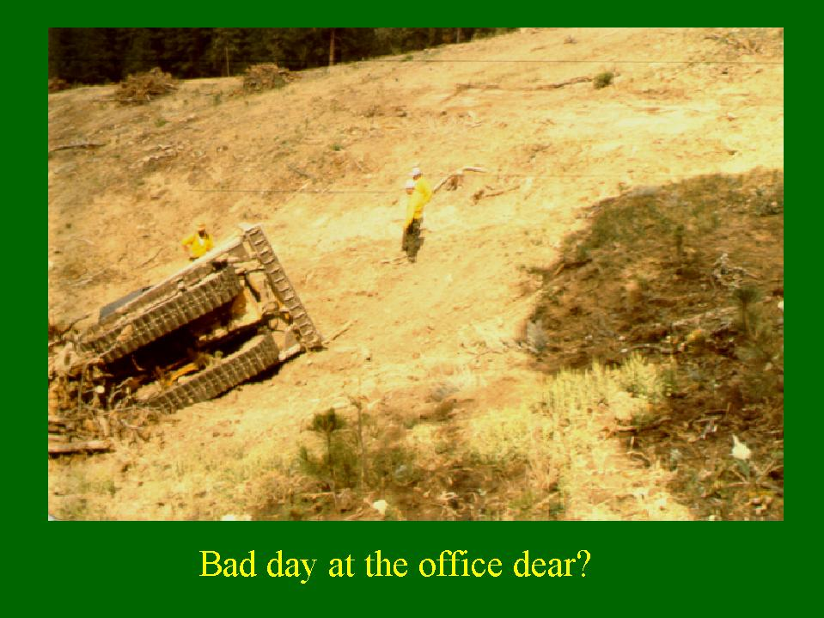

Slide 9
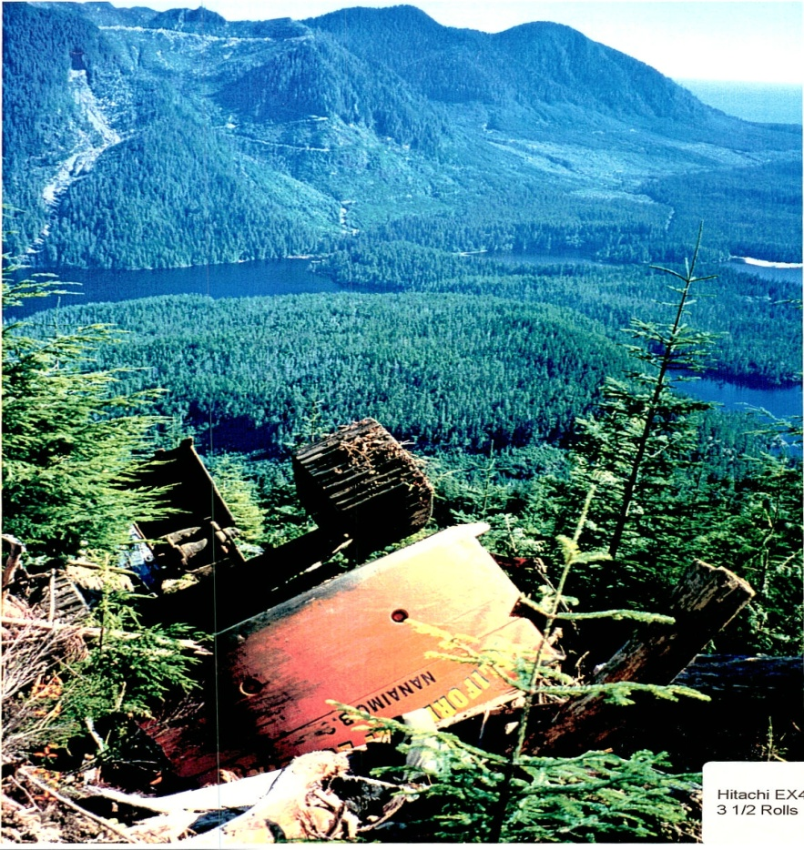
Machine tip overs did occur
Not many fatalities
Some tip overs not reportable by uncovered workers & sole proprietors using machines not meeting Div 7 codes.
Similar experiences in other states and countries
Other states relied on federal logging standard that depended on the boom to protect operator and did not adopt any guarding restrictions on tethered logging machines
Research and testing indicated severe consequences for operator in rollover event

Slide 10
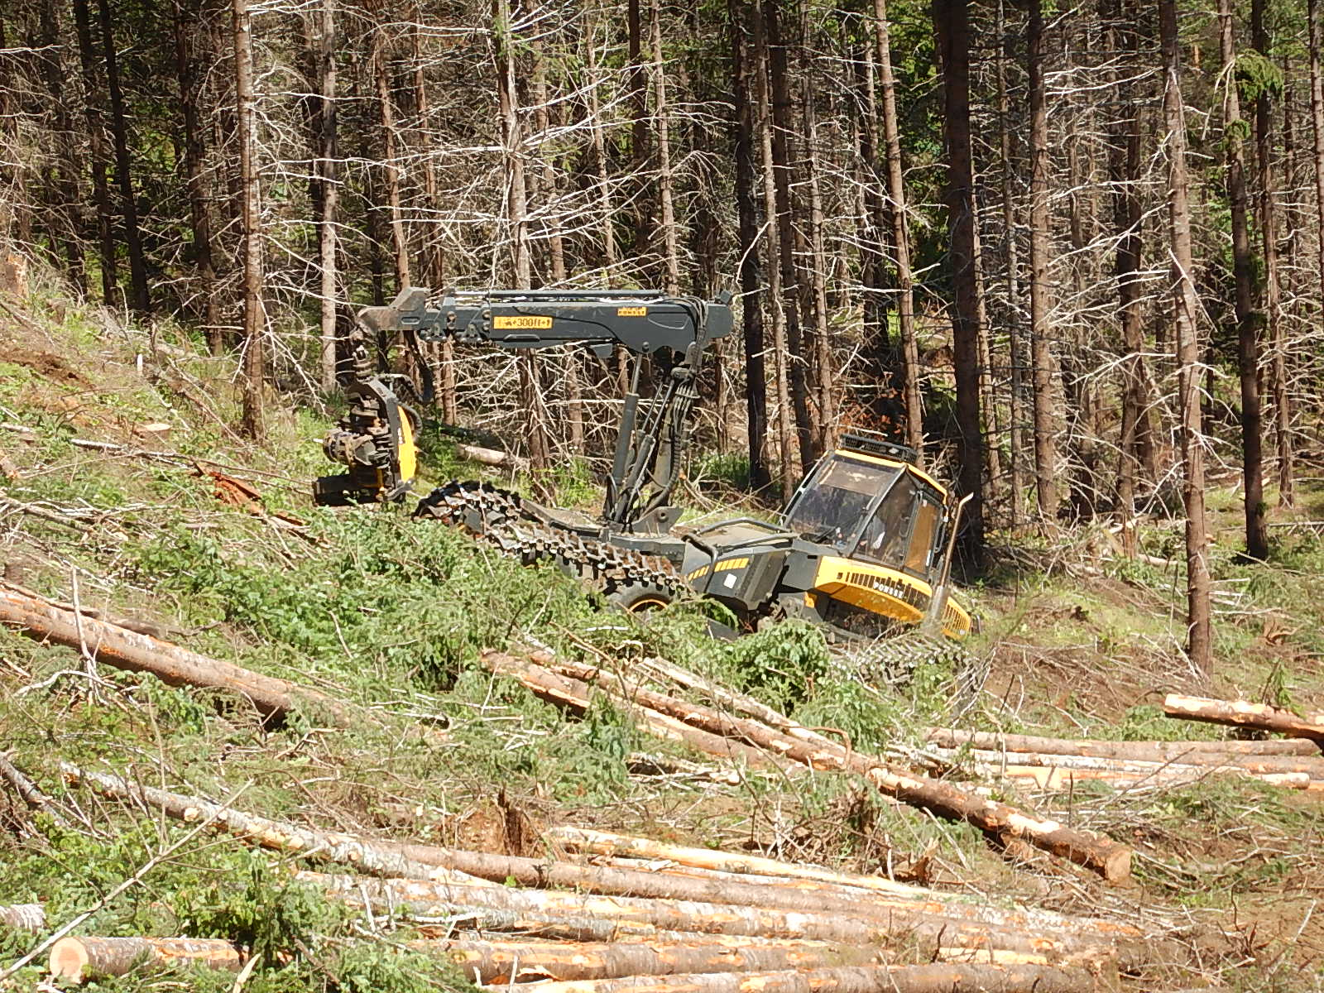
PONSSE systems in OR & PNW only machines approved by co.
For over 50%--no upper %

Slide 11
Accidents can happen

Slide 12
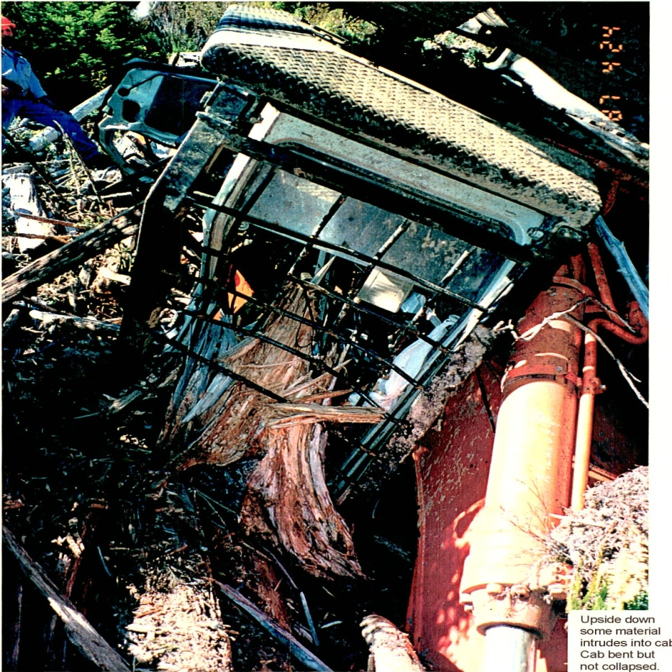
Regulations as well as Best Practices guides
BC has specific regulations and combines general ones in a guide using practices similar to OR variance
Chile has landowner safety mandates. Brazil similar.
New Zealand has Section 6.4 of the Approved Code of Practice with engineered and tested, plus criminal liability possible
California has resource protection but not safety
ID has safety regulations covering cable assisted logging operations
WA has Best Practices guidance & existing rules for logging systems

Slide 13
Why the concern?

Slide 14
Variance results to date (6/16 - 12/23)
41 research variances open…a few quit tethered logging
Total recordable injuries 2016-2023 one hand injury while spooling cable
Two anchor machine tipovers w/o bodily injuries
Reported hours of operation >50% 110,774
That would take at least 443,096 hand cutter hours
Translates into ~233 cutter years w/o risks
Remaining areas for hand falling- worst of the worst

Slide 15
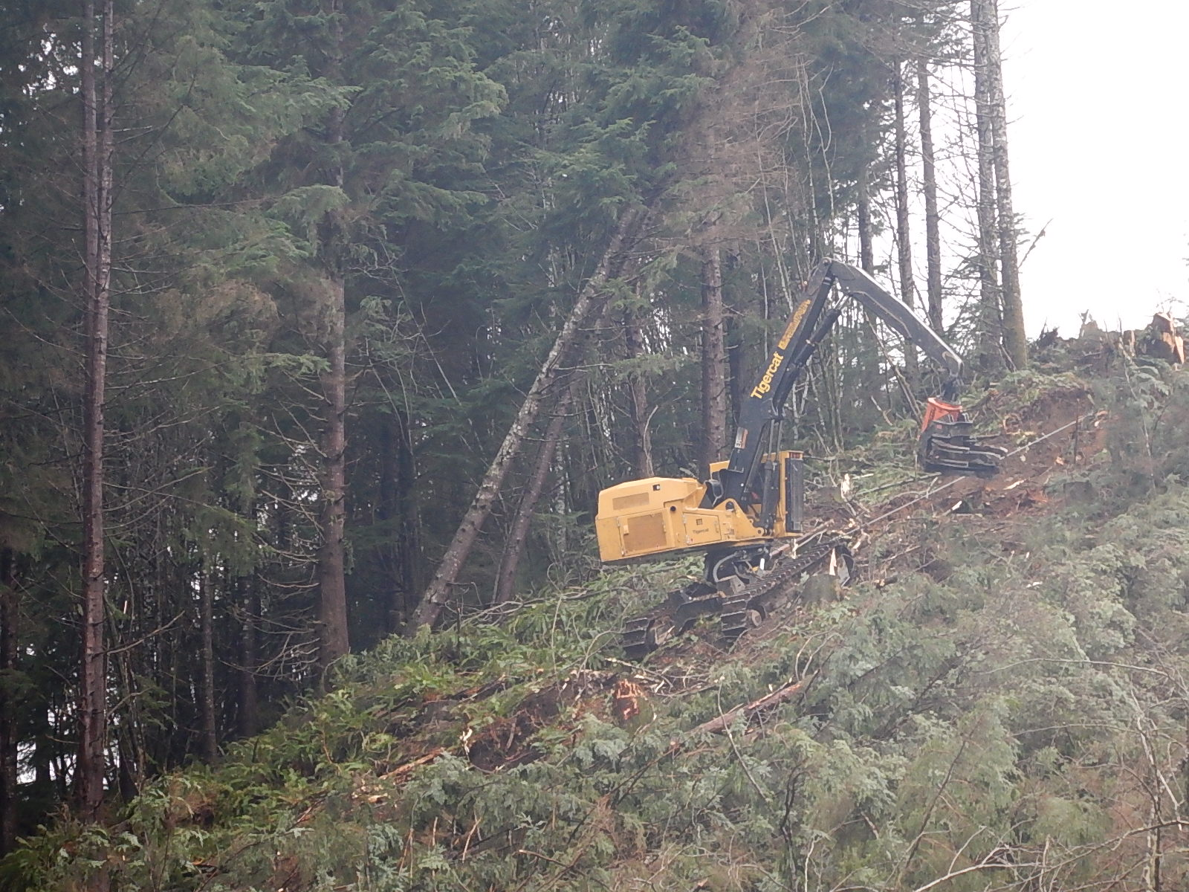
Ability to deal with hazards: wind and windthrow, snags

Slide 16
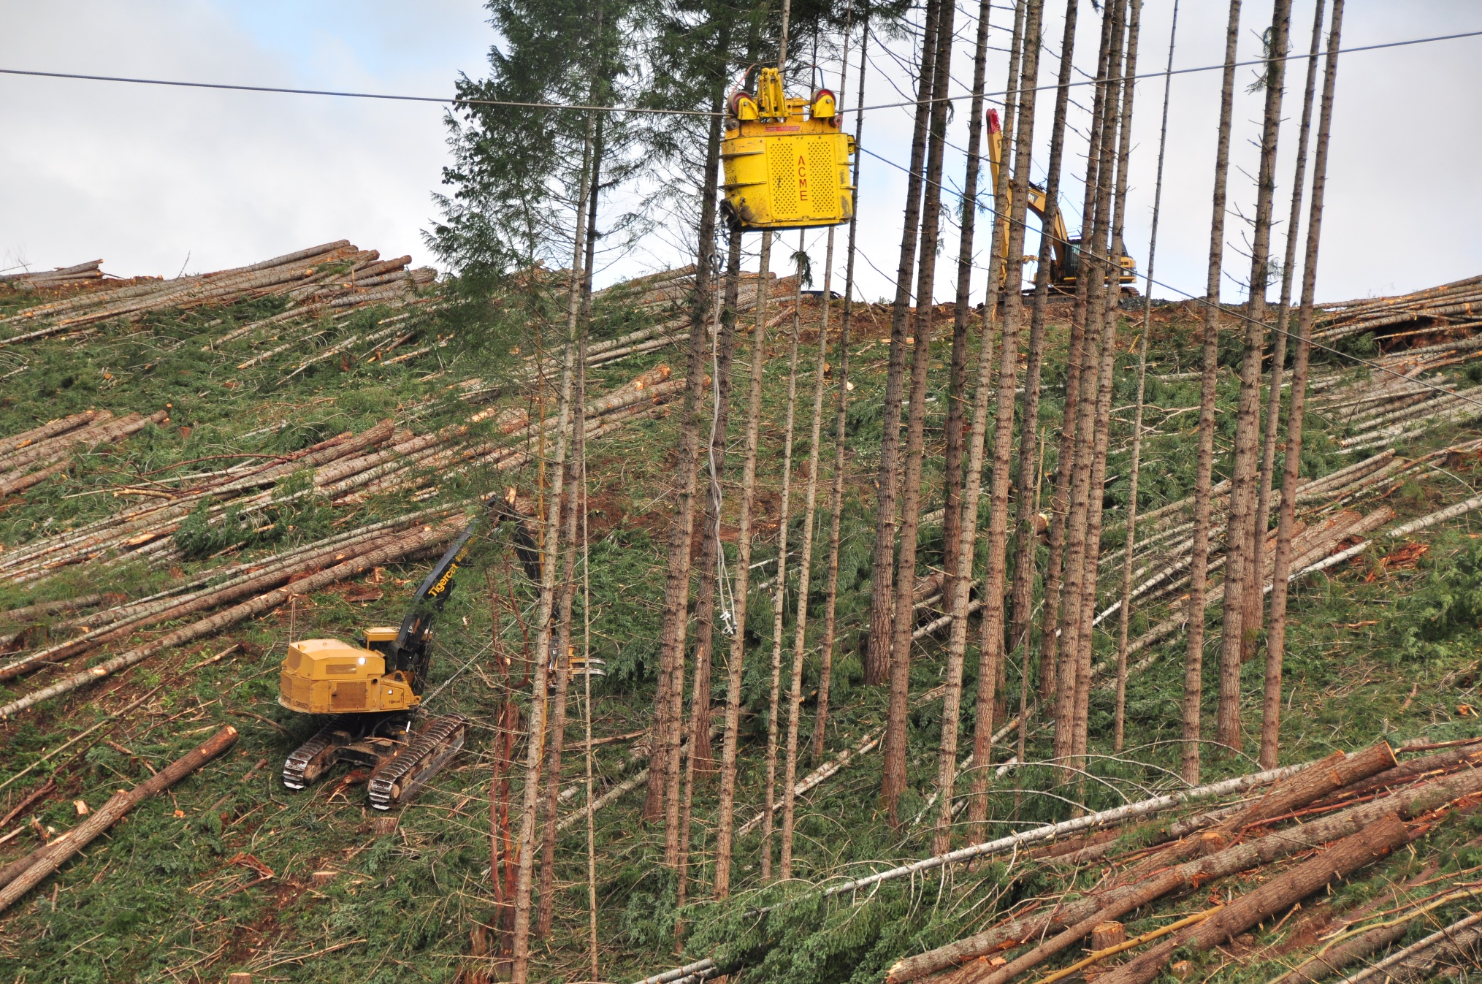
Opportunities to make yarding safer
PACIFIC NORTHWEST AGRICULTURAL SAFETY AND HEALTH CENTER

Slide 17
Forest Activities Advisory Committee
Primary source division 7 rulemaking
OROSHA management not considering div 7 rules in 2024
Rulemaking to be considered when OROSHA assured rules not in conflict with forest practices agencies
FACC open for participation quarterly at AOL office
For more information from OROSHA on variance, Tom.Bozicevic@dcbs.Oregon.Com

Slide 18
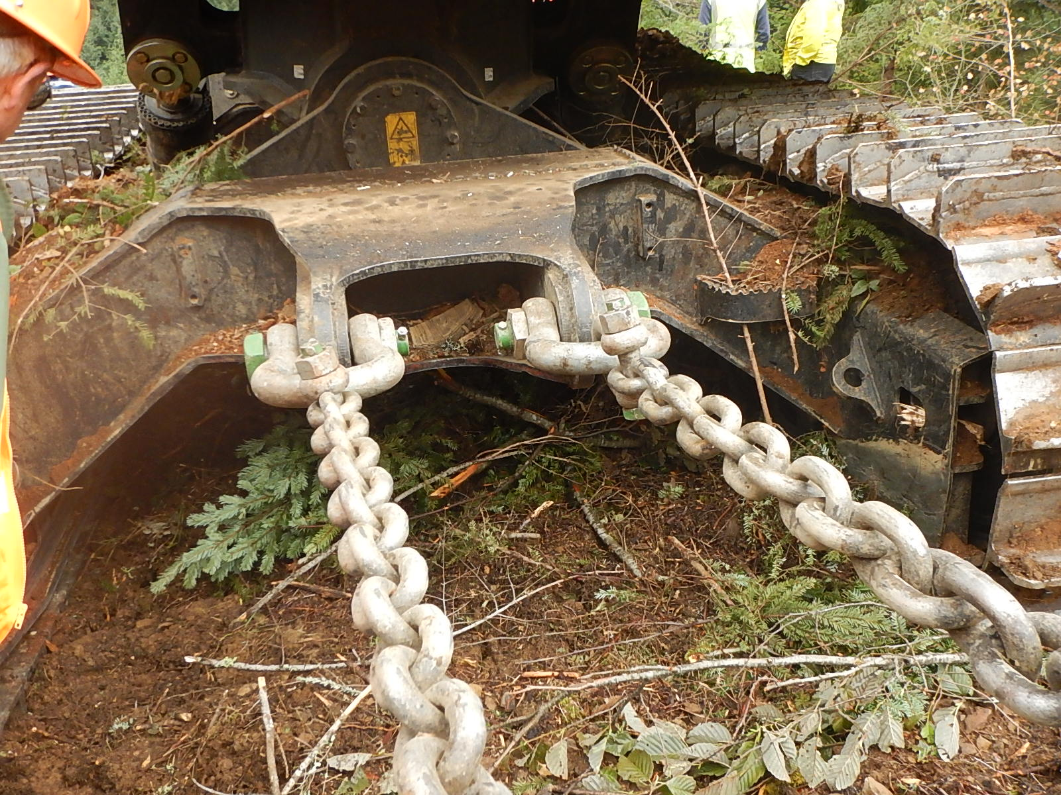
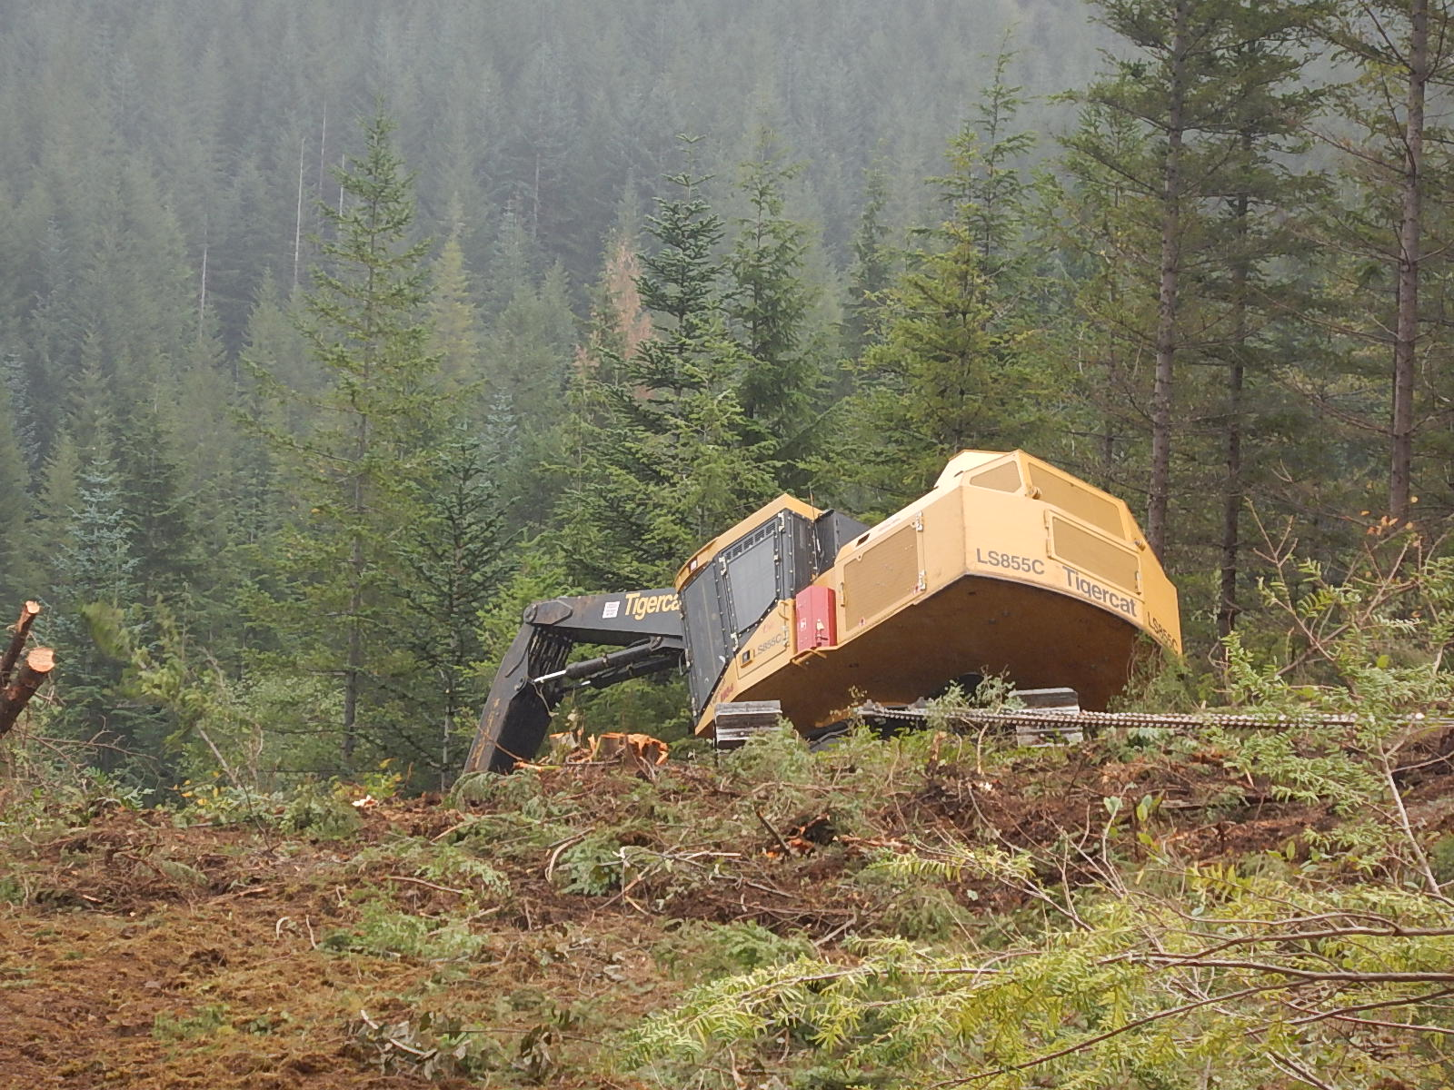
Tethering on steep slopes is continuing… issues need attention, research is needed

Slide 20


THANK YOU!
Questions?
Dr. John Garland, PE
Consulting Forest Engineer
Affiliate Prof, Department of Environmental and Occupational Health Sciences University of Washington
Prof Emeritus, Forest Engineering, Resources and Management, OSU
johngarland49@gmail.com
541-231-6241
Notes:
EXAMPLE USE OF THANK YOU SLIDE

