Slide 1




Hidden Hands: Latino Immigrant Forestry Services Workers in the Pacific Northwest
Marcy Harrington, Butch de Castro, Carl Wilmsen, Victoria Breckwich Vasquez, Diane Bush, Dinorah Barton-Antonio, Virginia Camberos
ISASH Annual Conference, June 19, 2024
Northwest Forest Worker Center
Project funded by CDC-NIOSH 1U01OH010814
Notes:
PNASH (Marcy)
NFWC (Carl)

Slide 2
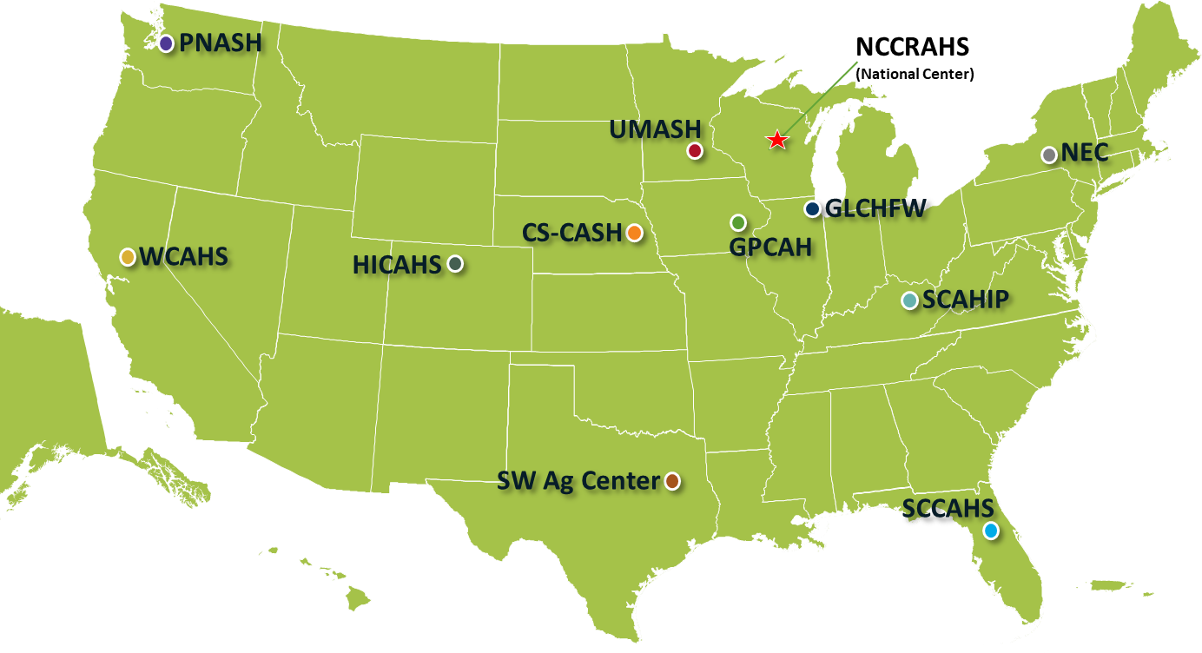
NIOSH Centers for Agriculture Safety and Health
CS-CASH - Central States Center for Agricultural Safety and Health
HICAHS - High Plains Intermountain Center for Agricultural Health and Safety
GLCFHW - Great Lakes Center for Farmworker Health and Well-being
GPCAH - Great Plains Center for Agricultural Health
PNASH - Pacific Northwest Agricultural Safety and Health Center
NCCRAHS - National Children's Center for Rural and Agricultural Health and Safety
NEC - Northeast Center for Occupational Health and Safety
SCAHIP - Southeast Center for Agricultural Health and Injury Prevention
SCCAHS - Southeastern Coastal Center for Agricultural Health and Safety
SW Ag Center - Southwest Center for Agricultural Health, Injury Prevention and Education
UMASH - Upper Midwest Agricultural Safety and Health Center
WCAHS - Western Center for Agricultural Health and Safety

Slide 3
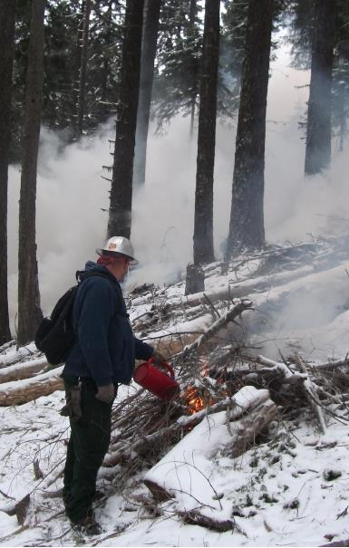
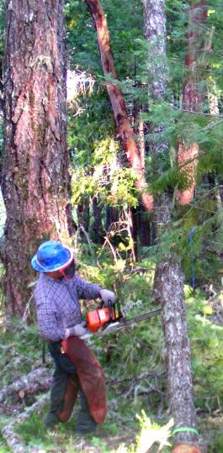
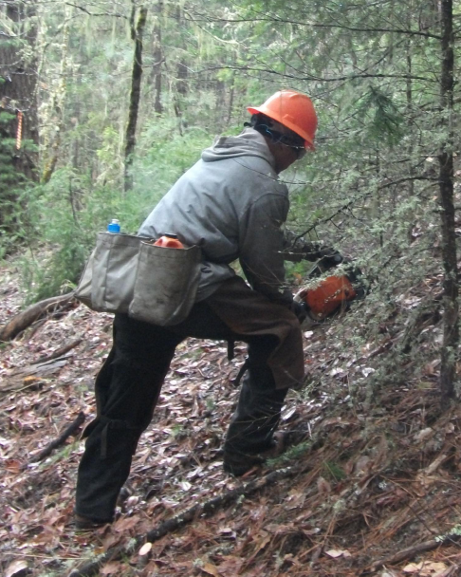
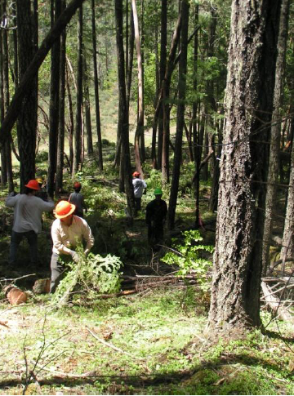
Thinning Working on Slopes Clearing Brush Controlled Burns

Slide 4
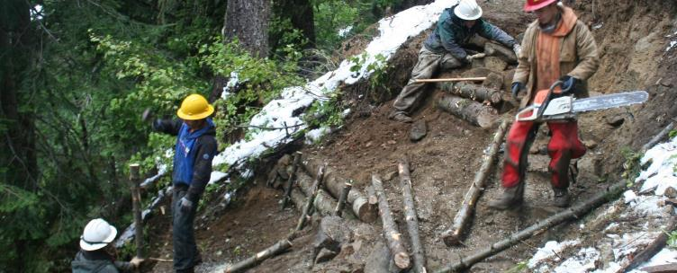
Erosion Control

Slide 5
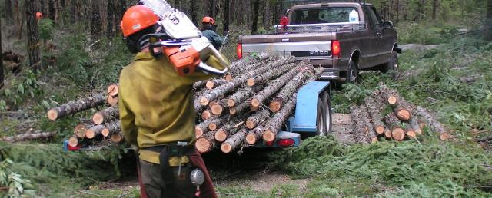
Lifting and Hauling

Slide 6
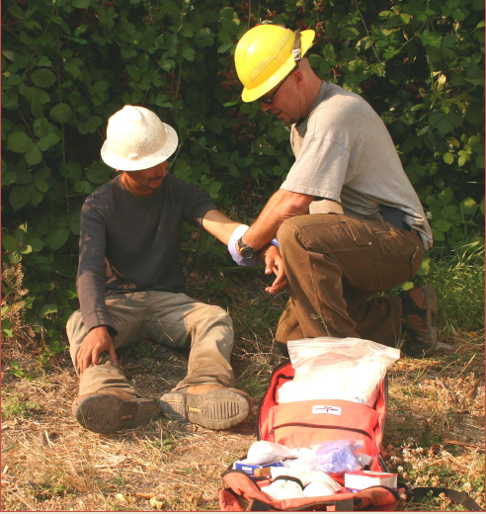
Working Conditions
High risk for injury and illness; rarely receive safety training or health benefits
Heavy, dangerous equipment
Fast-paced
Remote, isolated locations; unstable terrain
Low pay and wage theft
Employment insecurity

Slide 7
Project Goals
Characterize job-related injury and illness experiences in relation to workplace risk factors and outcomes in medical treatment, recovery/return-to-work, and safety mitigation
Investigate circumstances under which workers report injuries to supervisors, seek medical care, and make attempts to improve safety and health at work
Develop narrative storytelling educational resources for workers and employers
Deliver educational trainings; evaluated for effectiveness

Slide 8
Project Phases
Phase I. Employer, supervisor interviews (n=8); site observations
Phase II Worker interviews (n=99)
Case study interviews (n=23)
Phase III. Developed worker digital stories & worksite safety talks
Promotora-led training

Slide 9
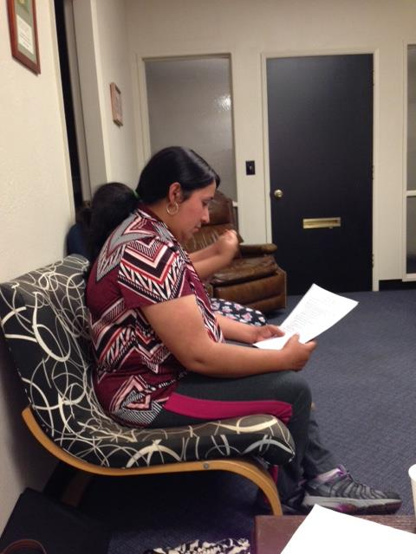
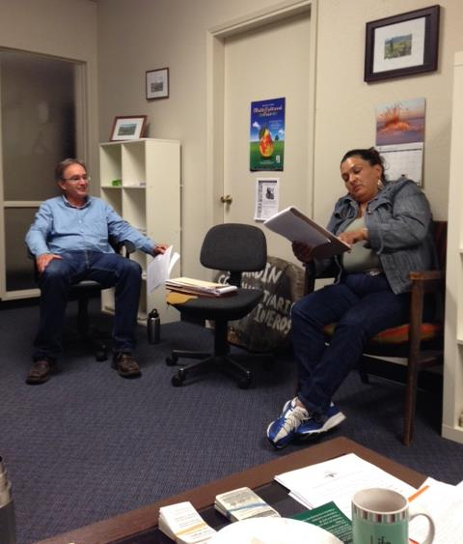
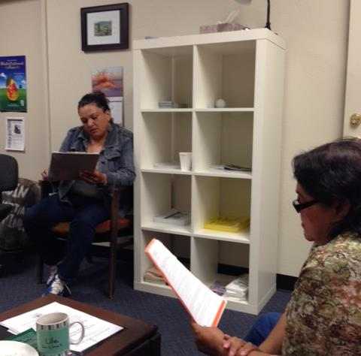
Promotores Program (NFWC)

Slide 10
Technical Advisory Group (Employers & Safety)
  Input on survey tool for employer/supervisor interviews (Phase I)
  Advice on employer/supervisor participant recruitment (Phase I)
  Perspective on worksite observation visits (Phase I)
  Guidance on safety talks and recommendations (Phase III)

Slide 11
Expert Working Group (Workers)
  Input on survey tool for worker interviews (Phase II)
  Advice on worker participant recruitment (Phase II)
  Review (external validation) of preliminary results (Phase II)
  Perspective on training materials and evaluation process
  (Phase III)
Notes:
People who are minoritized endure mistreatment and face prejudices that are enforced upon them because of situations outside of their control.

Slide 12
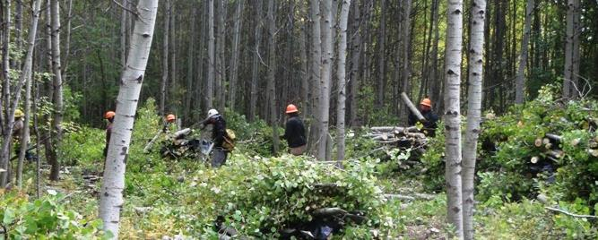
Employer and Supervisor Interviews

Slide 13
Employer & Supervisor Recommendations (8)
Slower pace of work. Land managers accept that higher costs are needed to support training and a slower pace of work.
Communications. “Have continuous communication up and down the hierarchy of managers through daily emails; reporting.” Also, need immediate communications to address unsafe behaviors.
Continuous improvement. Learning is central to safety success. “Investigate, learn, train. We had an incident where the workers were working too close…. We changed the way we work.”
Training. “Regular safety meeting, site plans, crew involvement in site plan.”
Monitor the industry. Award contracts to those complying with the rules. One suggested more OSHA inspections. “Migrating companies are not inspected. They can’t find the workers. They don’t go out to the field. Companies play the odds.”
Notes:
Competitive bidding “drags down safety.” Other contractors circumvent the law, reducing costs, and bid lower.
“The government tries to get best value to the government.”
“Financial. Forest Service taking the lowest bid. Then they cut corners; abuse workers; cut safety.”
“Government awarding low bids. They don’t take safety and health into consideration. Contracting officers say that safety and health is not their problem, not their job. It’s like slave labor. It makes me mad.”
“There is underreporting in the industry so competitors can bid cheaper. Our profits are less because we train.”
Hiring undocumented workers related to problem of contractors disregarding the law.
Our interviewees estimated that 60 to 80% of the workforce in southern Oregon is undocumented. Contractors take advantage of the workers, instilling fear.

Slide 14
Worker Interviews

Slide 15
Worker Participants (99)
Eligibility: - Injured on the job in the previous 2 years, or
- Taken action to improve working conditions.
Men with an average age of 30 years.
All were Spanish speakers, 22 also spoke English.
At least 15 different forestry services companies were represented in
our sample. (Twenty workers did not state their employer’s name.)
Workers had been with their current employer for an average of 3.3
years, and had been working in forestry for 9 years.
Thirty-seven of the workers were in the United States on H-2B visas.
Notes:
99 interviews served as pre-selection interviews from which a subset of 23 interviewees were identified for a case study interview

Slide 16
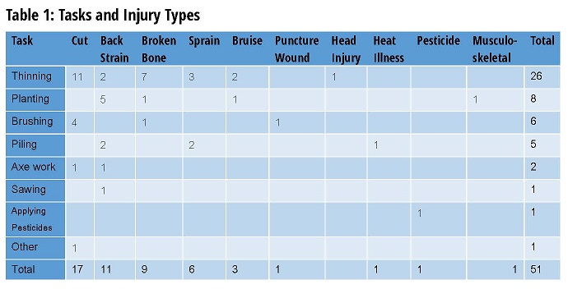

Slide 17
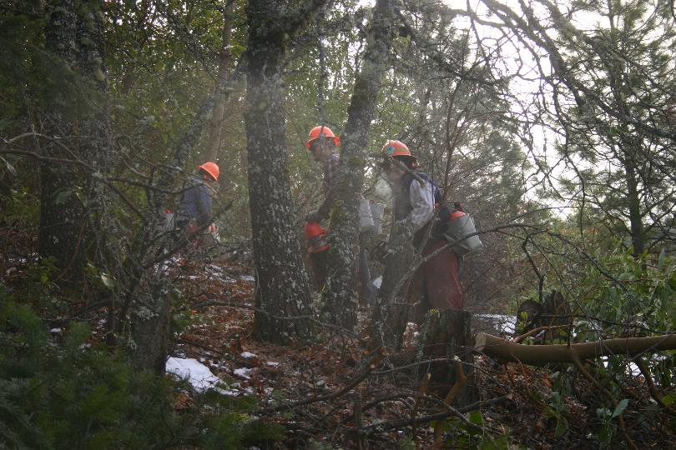
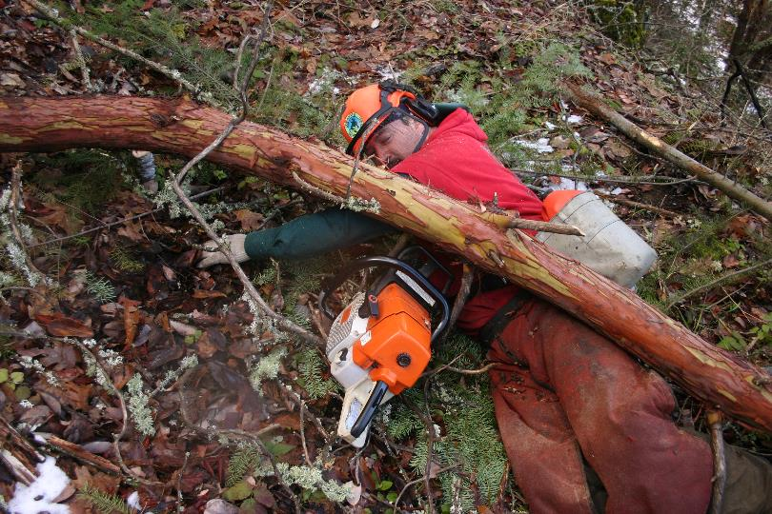
Struck-By-Object
Working too Close together
Lack of Communication

Slide 18
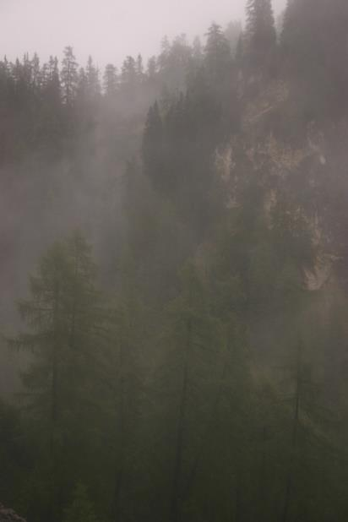
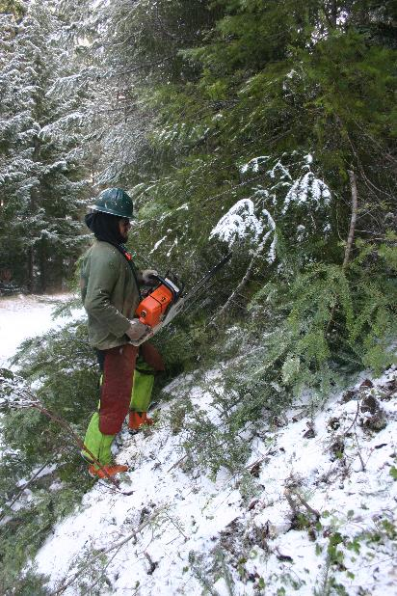
Slips, Trips, & Falls
Low Visibility
Physical environment: Wet, Steep slopes

Slide 19
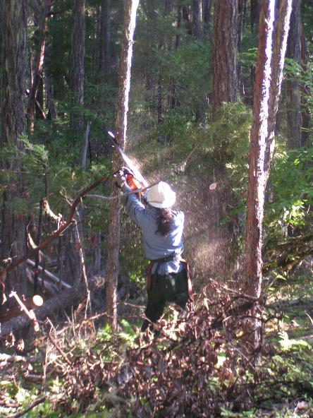
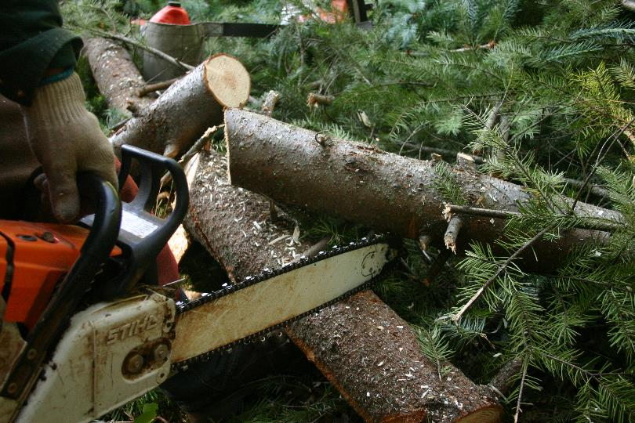
Chainsaw Kickback
Saw tip Hitting an object
Reaching too high

Slide 20
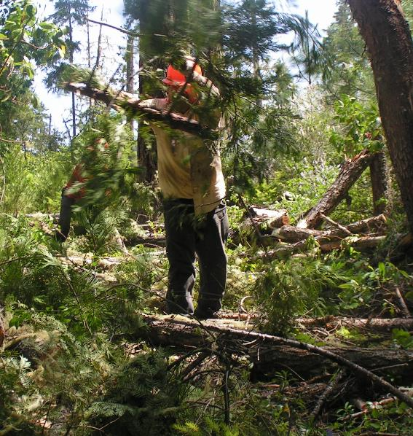
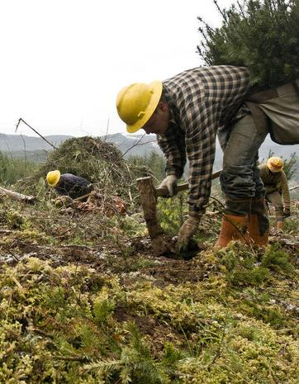
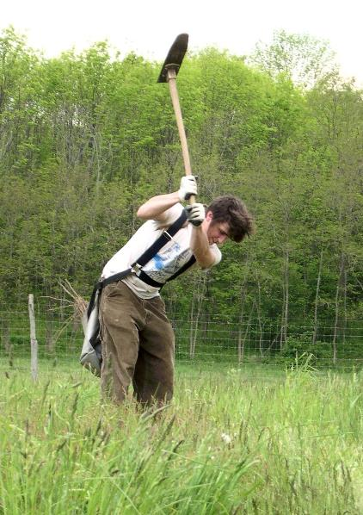
Back Strain
Piling heavy brusH
jumping Hard Ground

Slide 21
Underlying Causes:
Safety Climate Factors Affecting Injuries
Abusive supervision – 29% of interviewees
Organization of work in an unsafe manner
Lack of safety training – only 25% received
Failure to conduct on-site inspections – only 19%
Failure to maintain or provide effective tools & PPE

Slide 22
Abusive Supervision & Retaliation
“I was afraid to say anything because sometimes if you say something, they fire you. “
“When I told the foreman how I was feeling, he said “it’s nothing,” and got on my case and told me to hurry up and quit f***ing around.”
“Because in reality, the day that you’re of no use to the company, they just get rid of you, and that’s it.”

Slide 23
Collective Action
”Because other coworkers started doing the same, and we said we were going to stop working.”
  – Forest worker explaining why the foreman gave him the chainsaw
  in better working condition he had asked for.
“One time we were thinning really close together. There were 7 of us, and I was afraid that a tree would get thrown on top of me. I was afraid to say anything because sometimes if you say something, they fire you. But, I felt like I was in danger, so I resigned myself to being fired, and talked to my coworkers. We decided to work further apart from one another. The foreman just ignored us. He didn’t care what we were doing. He doesn’t care about us.”

Slide 24
Outcomes in Medical Treatment & Recovery/RTW
System Functional: worker received medical treatment and workers’ compensation benefits (7 workers; of 23 case studies)
System Failures: workers faced challenges in receiving medical care and/or workers’ compensation benefits (16 workers)
  not being taken by one’s employer to a healthcare professional for treatment of the injury
  being told to lie at the healthcare facility about work-relatedness of the injury
  not filling out form 801 and not receiving workers’ compensation benefits
  not being allowed to follow the physician’s orders with regard to light duty or recovery time away from work
  being fired or not rehired after being injured

Slide 25
Underlying Factors Affecting Injury Outcomes
Safety Climate – workers whose employers had indicators of safety climate were more likely to have recovered from their injuries and to have received workers’ compensation benefits
Interpretation at Medical Exam – workers for whom an interpreter that was unaffiliated with their employer were more likely to have better injury outcomes

Slide 26
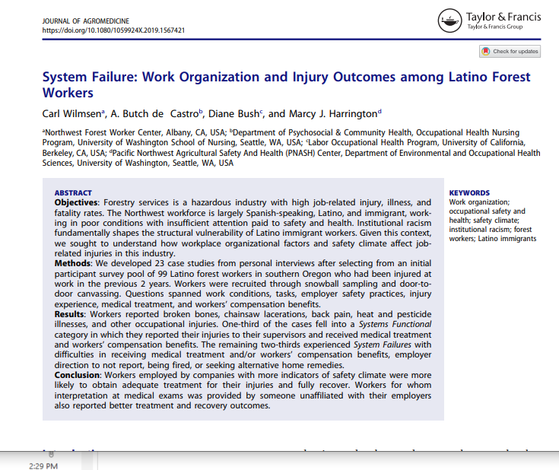

Slide 27
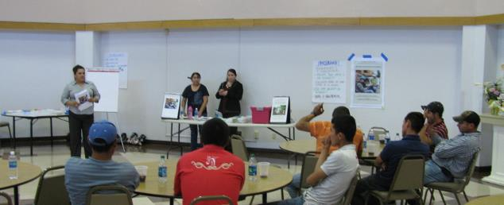
Training and Materials

Slide 28
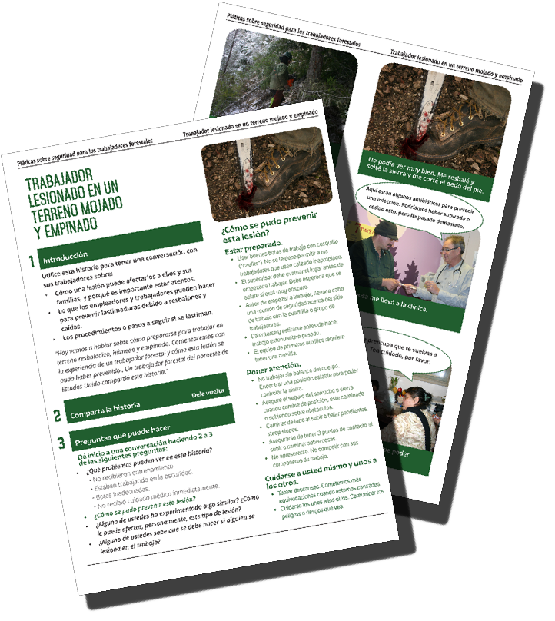
Safety Talks
Safety Talks based on real worker stories for use by supervisors (English & Spanish)
Struck by tree
Chainsaw kickback
Herbicide application
Speaking-up for safety
Notes:
Designed for supervisor

Slide 29
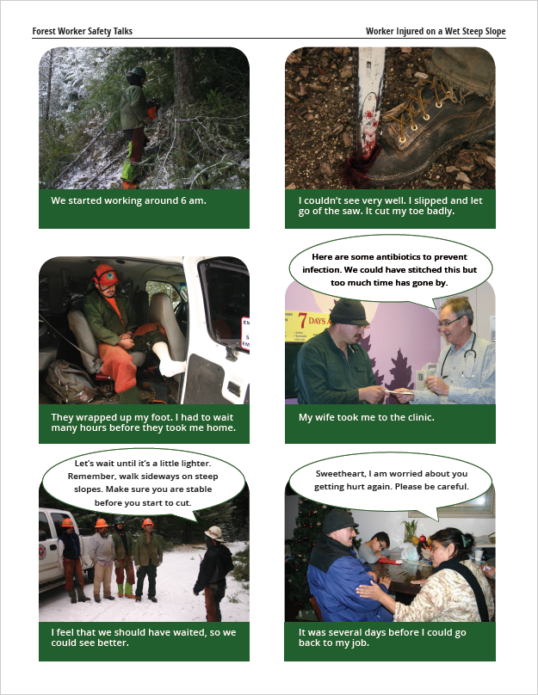
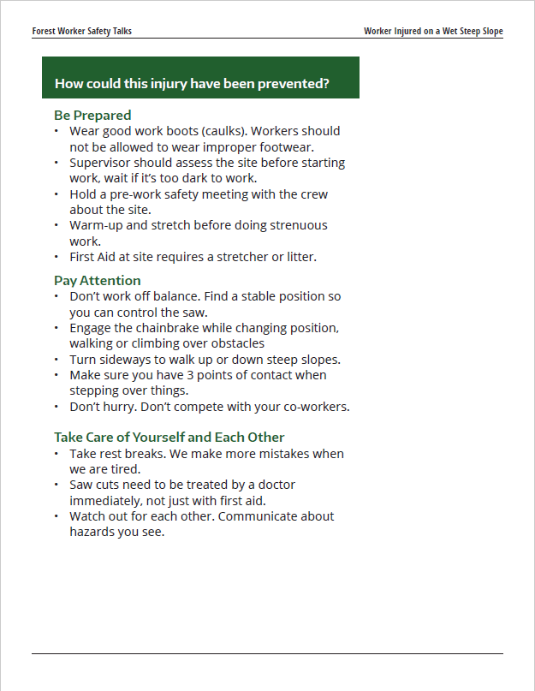
Notes:
Link to digital stories: https://spaces.hightail.com/space/PWhKh
dbush@berkeley.edu
Medford

Slide 30
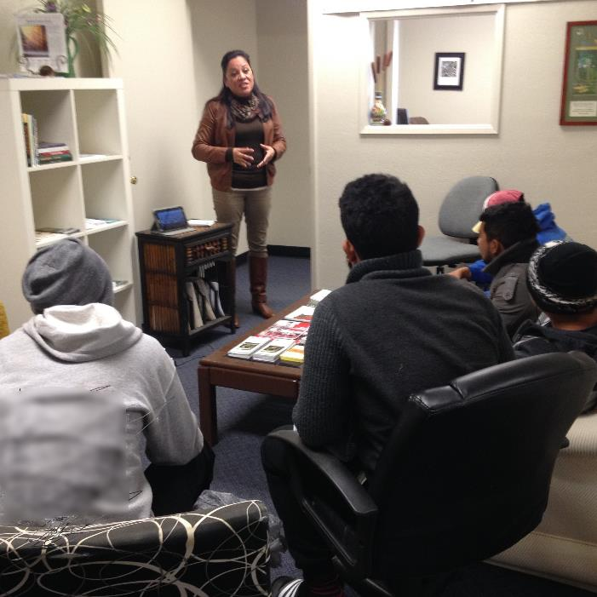
Personal Narrative Educational Videos & Trainings
Video historias reales/
Reality Tales Videos
Promotores training cards

Slide 31
RESOURCES
PNASH
http://deohs.washington.edu/pnash/forest_safety
NW Forest Worker Center
https://nwforestworkers.org

Slide 32
Questions/Discussion

Slide 33
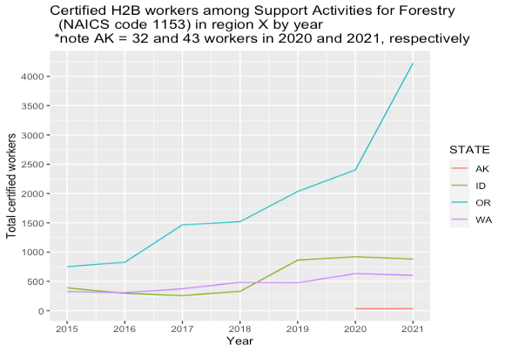
NW Forestry Support Guest Workers (H2B Visas)
Source: US Department of Labor, 2015-21

Slide 34
WA Logging Spanish Language Needs
Source: 5001-03 Risk Class. WA Dept. of Labor and Industries (LNI) 2024
Notes:
SHOWS - This does not show a strong trend line, but does provide some hard data speaking to the need.
THANK YOU to WA SHARP and the WA Logging Safety Initiative for exploring this question with us on the need for Spanish language in logging.
SOURCE - This data is drawn from the WA Workers Compensation Program and include only accepted injury claims from loggers – spanning 2011 to 2023. It includes timber fallers, workers in tower logging – choker setters, chasers etc. It excludes log truck drivers, mechanized logging (machine operators)
Note from Dave Bonauto:
These are state fund accepted claims in the 5001 -03 risk class, which will include employers in the LSI program risk groups (555X).
So these are timber fallers, workers in tower logging – choker setters, chasers etc. It excludes log truck drivers, mechanized logging (machine operators), clerical staff, etc.
While risk classification overlaps with industry, it will also bring in additional logging injuries that are not in the NAICS 1133. For example, a land clearing company or arborist may do loggin activities and if so will report hours (and injuries) in the risk classification and will not be captured in the NAICS 1133. So that is the likely explanation why the risk class Spanish language preferred claims in 2015 exceed those reported for NAICS 1311.
As you know there is likely differential underreporting of injuries to workers compensation with Latin(a) workers underreporting more – even though we need more data to support this statement.

Slide 35
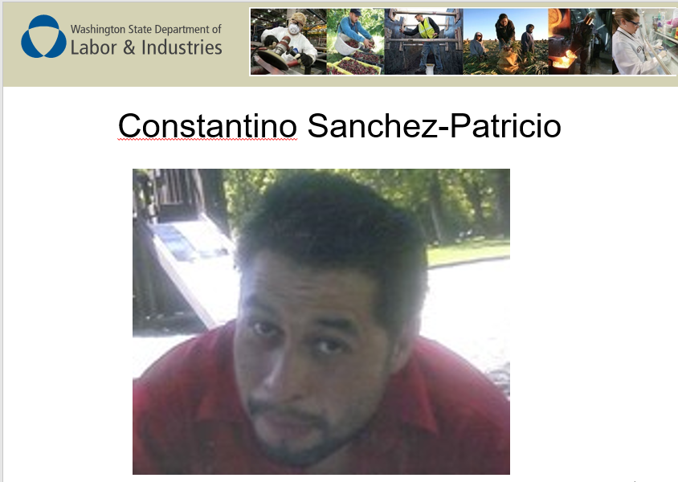
Notes:
Shared by SHARP:
One of the manual logging deaths in 2012 represents just how important Spanish language content might be – Constantino Sanchez-Patricio was 32 year old logger who died several days after a logging injury. The injury occurred 6 hours into his first day of work. He was a choker setter/rigging man assisting in a road change and was hit in the abdomen with a haywire; resulting in several broken ribs and abdominal injuries. He subsequently died ~ 4 days later as a result of his injuries.
DOSH inspection states – ‘Interviews with crew indicated that they had received instructed (sic) about staying away from lines and moving lines but were not instructed or understood what move a way meant or how to move away from a line or what bite meant.’ The rigging crew was described as ‘green’; it seems likely that the entire 4 person rigging crew was primarily Spanish speaking. The inspector noted that cable logging is a complex operation and the level of inexperience was not acceptable.

Slide 36
DISCUSSION
Safety Climate & Training. How can we best reach and train supervisors for this industry sector?
Contracts. What opportunities are there to improve government contracts to support safety?
(monitoring contractor performance, slower pace of work and training,
value of stewardship vs. profit)
Policies/Regulations. How might safety be improved through new policies and/or regulations?

Slide 37


THANK YOU
Marcy Harrington
marcyw@uw.edu
206-685-8962
Notes:
EXAMPLE USE OF THANK YOU SLIDE

