Slide 1




What do NW loggers say will improve safety & health?
A review of worker, supervisor, consultant, and researcher needs assessments.
Marcy Harrington, Evaluation & Outreach
Notes:
PNASH was recently renewed for another five years of funding through CDC-NIOSH – including a new investment in forestry – Rob Keefe’s location monitoring project being our first 5-year research project for forestry. As we launch our the next cycle of research, - we welcome your feedback, especially in areas where we can improve or addressing an emerging need.
More than anything, we hope you continue to partner with us and help us grow our network together so we can make a difference in safety and health.

Slide 2
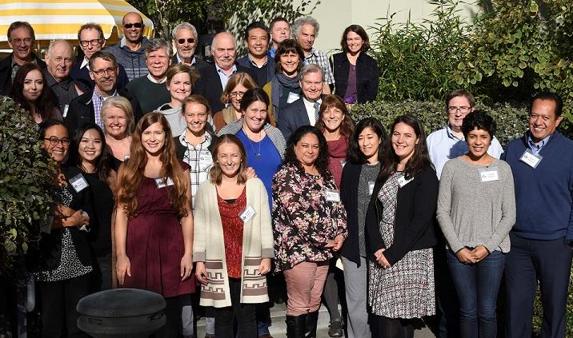


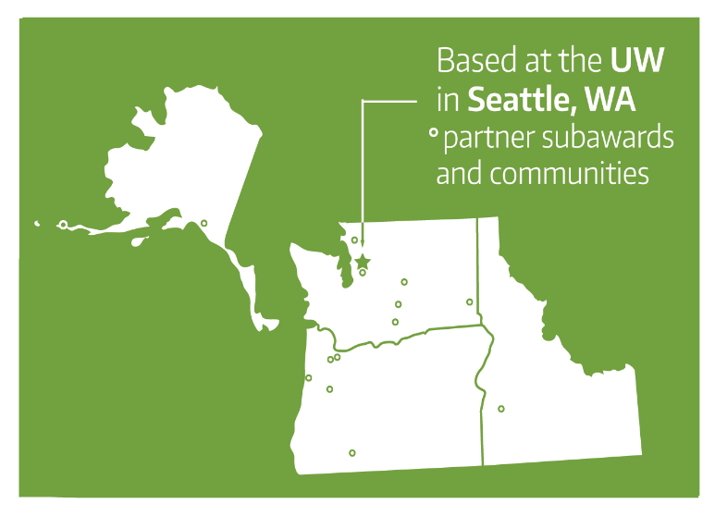
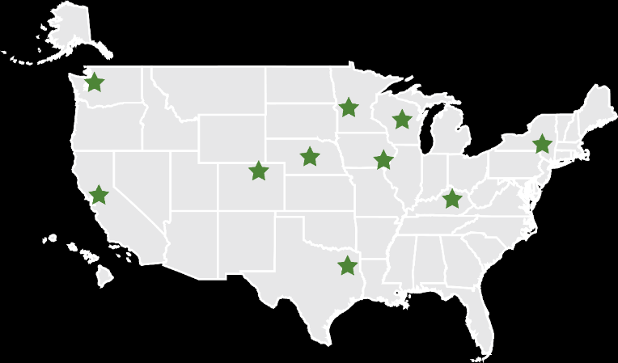
Notes:
The Center strives to promote safe workplaces, partner with workers and their communities, and transfer solutions to the workplace.
PNASH is based in Seattle, but we have several industry partners and communities located around the Pacific Northwest.
PNASH is one of eleven centers around the country funded by the Centers for Disease Control. These Centers were established to be regionally responsive to the nation’s agricultural safety and health issues by leading research, education, and prevention projects focused on industries with high-risk jobs.

Slide 3
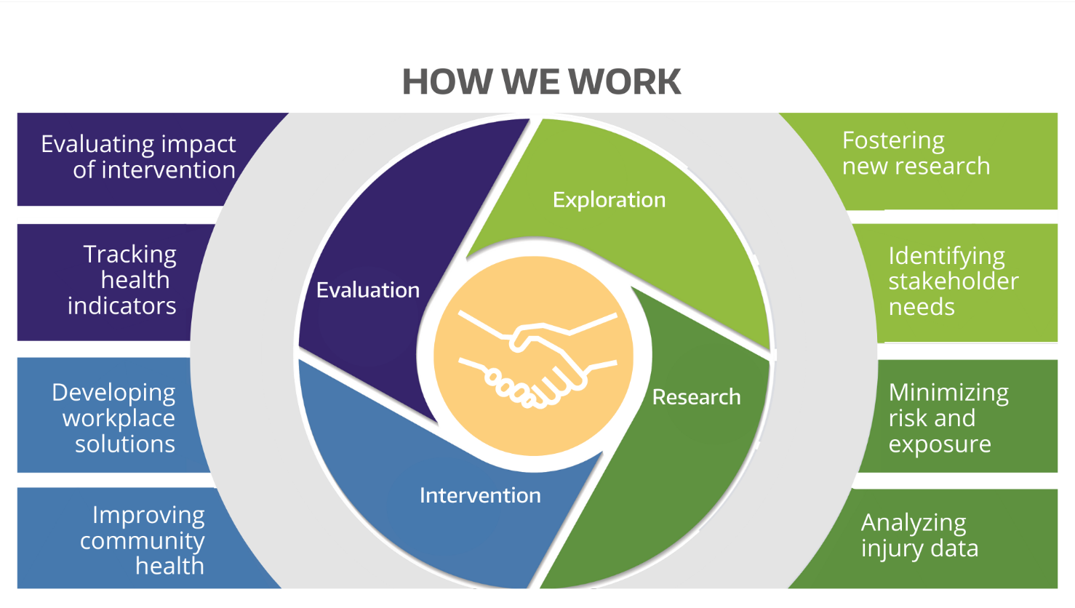
Notes:
The center and the outreach core serve as the bi-directional bridge between researchers and external partners to develop resources. This is an ongoing process of exploration, research, intervention, and evaluation. Things we've done in the past can help us be responsive now and in the future. For farming in particular, we have built capacity that is being carried over to fishing and forestry. We recognize that we're part of a larger process that means meeting people where they are at so we can amplify their efforts.

Slide 4







Partnering with Workers, Employers, and Communities
Health care providers
Employers and employees
Academics, researchers, and students
Local, state, and federal agencies
Community organizations
Health and safety professionals
Notes:
The Center seeks to partner with workers, employers, and communities to develop practical solutions for preventing injuries and illnesses. Here's an illustration of the partnerships we strive to cultivate. This work is a continuous cycle of exploring, researching, testing interventions, and evaluating progress. We utilize tools such as data science and visualization, mapping software, mobile apps, and risk assessment to characterize findings and translate the science into practical solutions.

Slide 5
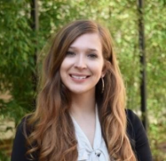

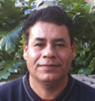

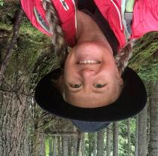

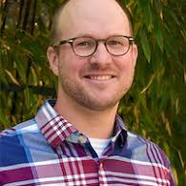
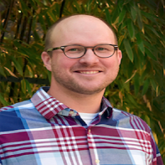

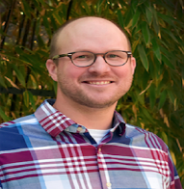
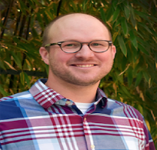

Dennise Drury
Sarah Fish
Pablo Palmández
Maria Blancas
Marcy Harrington
John Garland
Eddie Kasner
Notes:
We have an amazing and supportive Outreach Core team. The team consists of about a dozen individuals whose collective experience spans decades. Half of them speak Spanish and English. Many come from the communities and industries we serve. We wouldn't be able to do this work without them or their partnerships. I can't say enough about this team. It's an honor to work with them.

Slide 6
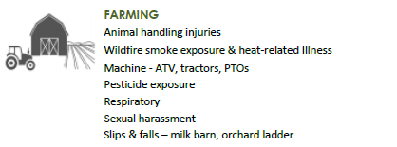
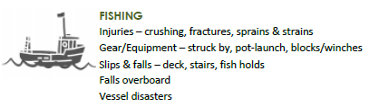
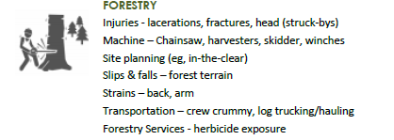
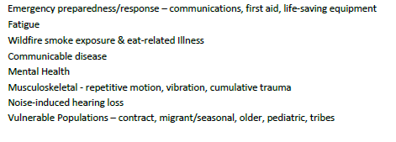
New Cycle Strategic Planning
PNASH Strategic Plan Priorities - 2021
Notes:
This cycle we will refresh these – through our review of data with RISC and our stakeholder advisory engagement

Slide 7
New Cycle Strategic Planning
PNASH Strategic Plan Priorities - 2021
Notes:
This cycle we will refresh these – through our review of data with RISC and our stakeholder advisory engagement

Slide 8

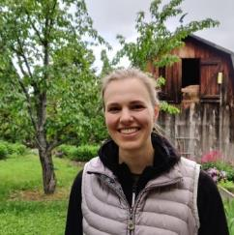



Research, NIOSH 2022-2027
Forestry Workforce Location- and Wearable-based Activity Recognition to Quantify on-the Job Digital Health and Safety Metrics
Principal Investigators: Robert Keefe, Associate Professor and Director, Experimental Forest;
Eloise Zimbelman, Postdoctoral Scholar, University of Idaho, Dept of Forest, Rangeland and Fire Sciences
A smartwatch app jointly with a location-sharing system to provide both location- and smartwatch activity-based information to improve situational awareness and reduce logging injuries.
SPECIFIC AIMS:
  Develop human activity recognition models needed to classify logging work activities
  in real-time using smartwatches
  Code and evaluate those models using a smartwatch app prototype
  Evaluate the smartwatch app jointly with a location-sharing system in active forest operations

Slide 9
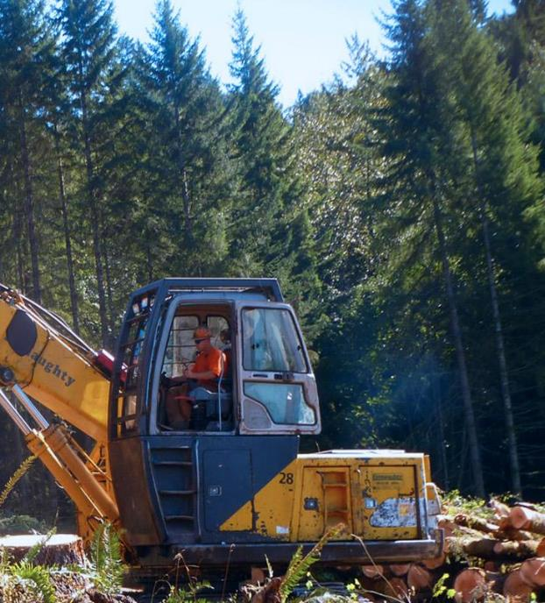
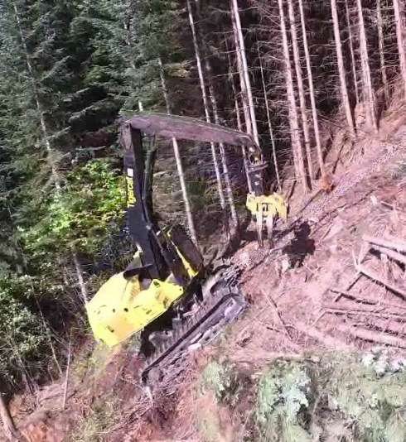
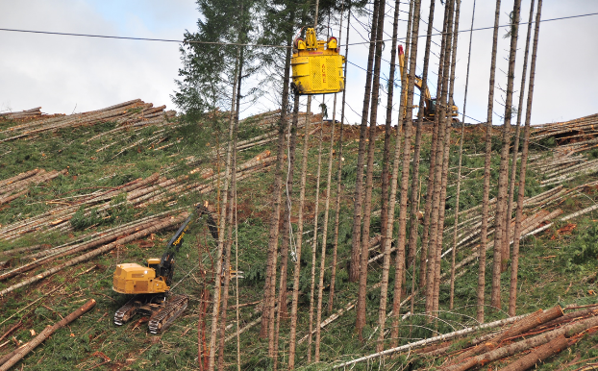
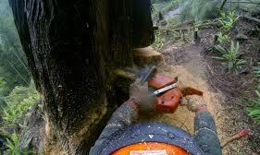
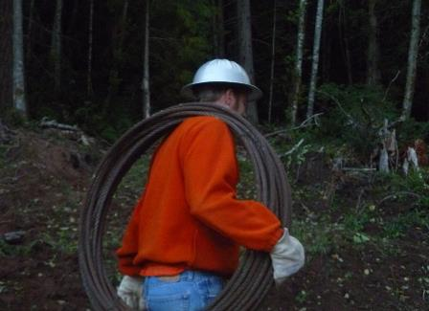
NW LOGGING
Steep slopes, dense forests, new mechanized technology

Slide 10
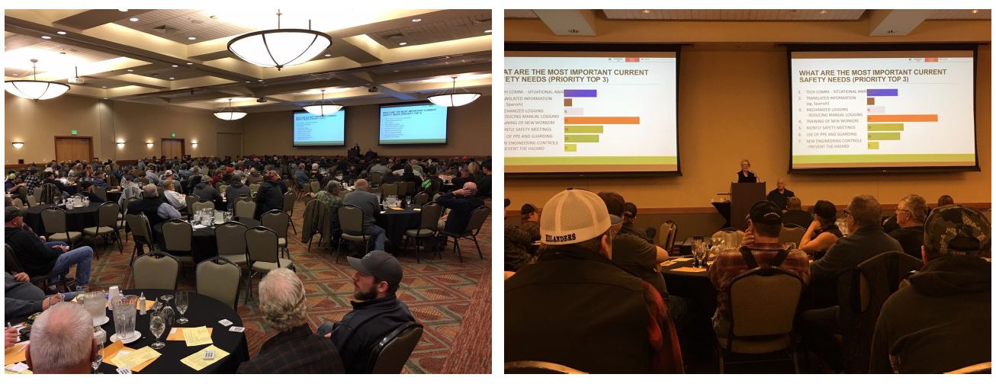
Contract Logger Polling and Safety Education
WA, OR, and ID 2018-2019

Slide 11
WHAT TRAINING TOPICS WOULD BE MOST USEFUL TO IMPROVE SAFETY? (PRIORITY TOP 3)
 | OR | WA | ID
SAFETY LEADERSHIP | 25% | 30% | 17%
CHAINSAW USE & MAINTENANCE | 9% | 7% | 7%
OTHER EQUIPMENT MAINTENANCE | 5% | 9% | 14%
DANGER TREES | 9% | 10% | 11%
FATIGUE & STRESS | 20% | 13% | 24%
FITNESS & HEALTH | 12% | 14% | 10%
GUARDING & LOCK-OUT/TAG-OUT | 5% | 10% | 7%
KNOWING BEST PPE OPTIONS | 9% | 5% | 5%
Notes:
Polling of 425 members identified: 1) Safety Needs (training new workers, room on landing zones, mechanized logging, location awareness); 2) Hazards (difficult terrain, woods roads, cutting, fatigue); 3) Health Issues (chronic back, muscle, or joint pain, poor sleep, hearing loss); and 4) Training Interests (fatigue, safety leadership, danger trees, fitness)
Safety leadership was most needed at 25% but combined needs for fitness & health plus fatigue & stress reached 32%.

Slide 12
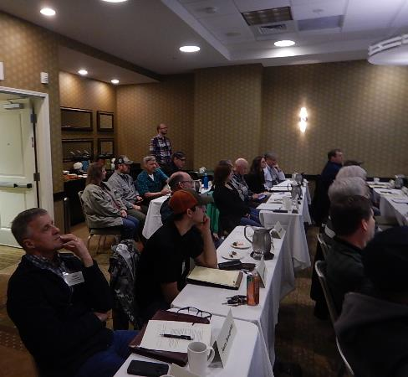
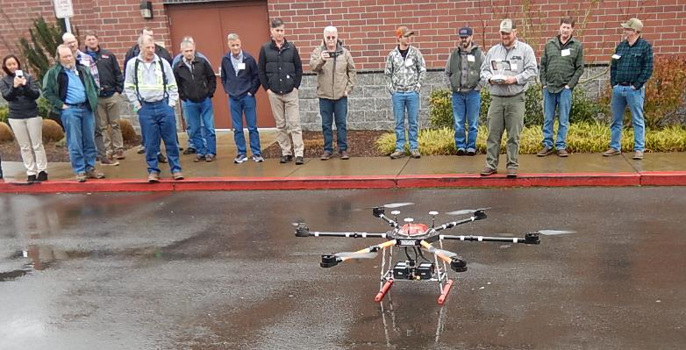
NW Logging Safety Summit
Feb 20, 2019, Springfield, OR
Notes:
ATTENDEES: 32 Northwest area logging safety educators and consultants (43 invited)
GOALS
Provide best training practices, new technologies and research results
Address new and emerging needs for logger safety
Build on expertise in the room with training tips, resource sharing and future planning

Slide 13
LOGGING SUMMIT - FUTURE PLANNING RESULTS
What trends will have the largest impact?
Job pressure - Short rotation-high productivity $$ compensation
Long term contracts with landowners
Safety leadership-top down
Benefit packages: Retirement, Insurance
What solutions and trainings can we develop?
Supervisor training / Train-the-trainer
Videos trainings
Training certification
Is there interest in a NW network of consultants? YES
What are ideas for the structure and future hosts?
▪ Website- private Facebook groups, email, text
▪ Rotating Responsibility. Sponsors, location, focus on a local/ need
▪ Workgroup/Task forces to tackle problems/milestones
▪ Safety alerts

Slide 14

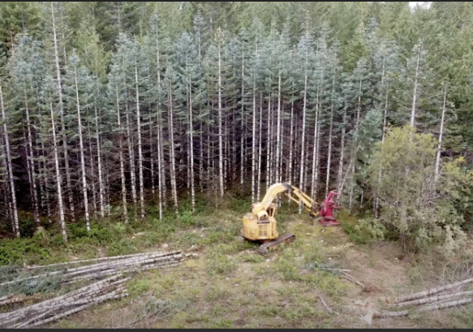
Western Regional S&H Conf
Forestry Safety Innovations and Populations Session, 2019
Notes:
Forestry Safety Innovations and Populations 2019. Research discussion (n=8) in conjunction with the Western Regional Ag Safety and Health Conference.
Slips, strips and falls - Intervention opportunities
Prescribed burns
Pesticides use in hand held sprayers
Workforce development
Train the trainer
Mechanization
How to define regional needs
Immigrant workforces
Salvage logging in burn areas and beetle kill

Slide 15
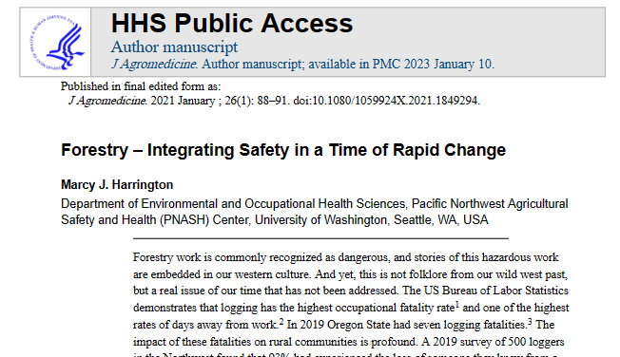
https://stacks.cdc.gov/view/cdc/123522

Slide 16
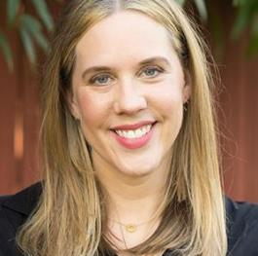
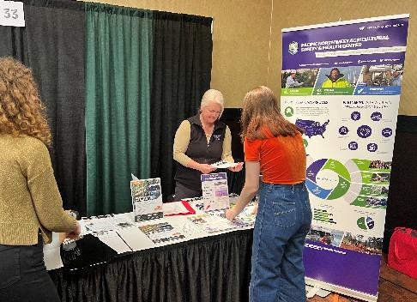
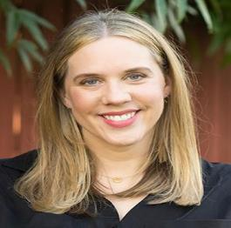
Pilot Project, NIOSH 2021-2023
Stress, Fatigue, and Injury Risk in Loggers and Log Truck Drivers: A Mixed Methods Study
Principal Investigator: Marissa Baker, Assistant Professor
46 logger & log truck drivers
9 in-depth interviews
48% of respondents were owner/operators
44% worked in logging industry more than 25 years
49% of respondents work more than 55 hrs/week
21% start their workday between 1:30am-4:30am
Notes:
Survey and interviews of Idaho loggers (n=46), including logging and trucking workers and employers.
Showed the value of: Safety culture, system solutions, collective action, high level of job satisfaction.

Slide 17
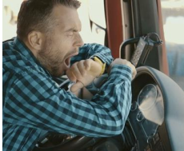
Results – Fatigue & Sleep
76% feel sleepy during work
67% get 5-7 hours of sleep;
9% less than 5 hours of sleep
More likely to use caffeine than taking a rest break
Most had no training on fatigue management
At some point every day, I'm like, "Oh, I'm kind of tired." And sometimes that's just a kind of a mental kind of noticing that my body and my mind is tired and my eyes might be tired.
One thing that I get that I think some other log truckers don't get is more variety, where I get to run the log loader sometimes or help out running the dozer. I think other guys don't get that as much, and I do enjoy that, being able to have some variety.
Notes:
High job satisfaction compared to many other trades!
Limitation: Small sample size, geographically limited, lack of detail in crash reporting on road conditions or driver condition
(Self and System) pressure to work longer hours and faster

Slide 18
Results – Job Demands & Support
Low stress, good health, strong job support & satisfaction
93% rate work high paced
37% didn’t take any breaks
-=
I like just the freedom of being able to line out my own day, do what I want during the day, and haul logs for who I want to a certain extent. Just being independent.
I wanted to get an extra load more than anybody and make more than anybody and be successful and more successful, maybe, than my competitors, do better and just work harder, and it's kind of a prideful thing.
Notes:
High job satisfaction compared to many other trades!
(Self and System) pressure to work longer hours and faster

Slide 19
Results – Loggers Exchange Log Trucking
Claims 2011-2021 (334 claims)
Top cause: overexertion, struck by object, falls
Top injuries: strains, contusions, fractures
60% claims from log truck drivers aged 45-64
58% those employed less than 3 years
24% collision and 76% non-collision related
Crashes top causes: Road/HWY (75%) vs. logging road,
other vehicle, slick conditions
Notes:
There is a lack of detail to drill down to root causes such at fatigue. Only a couple of cases reported fatigue or falling asleep at the wheel.

Slide 20
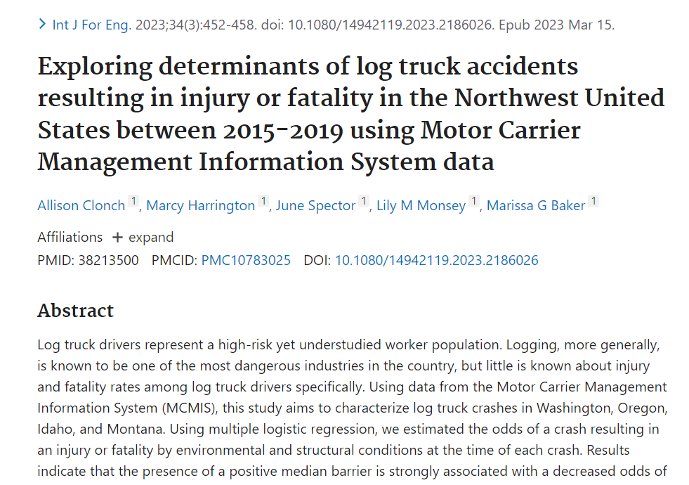

Slide 21
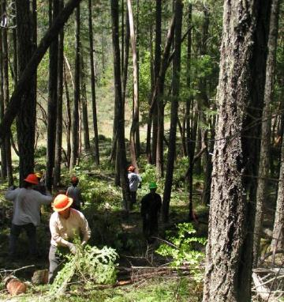
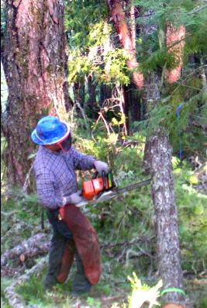
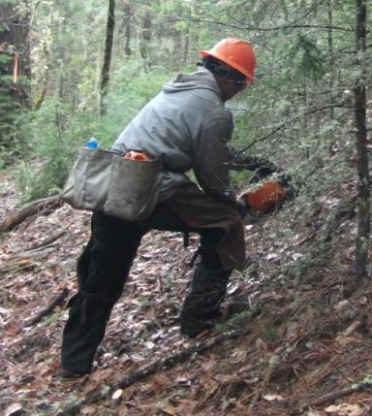
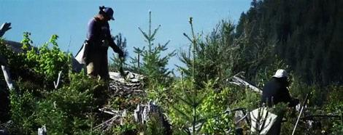
NW Forestry Services
Labor intensive, small contractors, Spanish speaking, seasonal, H2B

Slide 22



Project, NIOSH 2015-2018
Latino Immigrant Forestry Services Workers in the Pacific Northwest – Workforce Safety and Sustainability
Butch de Castro, Carl Wilmsen, Marcy Harrington, Victoria Breckwich Vasquez,
Diane Bush, Dinorah Barton-Antonio, Virginia Camberos, Sara Post
Northwest Forest Worker Center
Notes:
Survey and interviews of Idaho loggers (n=46), including logging and trucking workers and employers.
Showed the value of: Safety culture, system solutions, collective action, high level of job satisfaction.

Slide 23
Employer & Supervisor Recommendations
Slower pace of work. Land managers accept that higher costs are needed to support training and a slower pace of work.
Communications. “Have continuous communication up and down the hierarchy of managers through daily emails; reporting.” Also, need immediate communications to address unsafe behaviors.
Continuous improvement. Learning is central to safety success. “Investigate, learn, train. We had an incident where the workers were working too close…. We changed the way we work so that now we have a few workers working ahead dropping trees, and a crew working behind them bucking.”
Training. Regular safety meeting, site plans, “crew involvement in site plan.”
Monitor the industry. Award contracts to those complying with the rules. One suggested more OSHA inspections. “Migrating companies are not inspected. They can’t find the workers. They don’t go out to the field. Companies play the odds.”

Slide 24
Worker participants (99)
Forest workers who had been injured on the job in the previous 2 years or had taken some kind of action to improve working conditions.
99 interviews served as pre-selection interviews from which a subset of 25 interviewees were identified for a case study interview.
  Men with an average age of 31.6 years.
  All were Spanish speakers, but 22 also spoke English.
  At least 29 different forestry services companies were represented in our sample.
  (Twenty workers did not state their employer’s name.)
  Workers had been with their current employer for an average of 3.3 years,
  and had been working in forestry for 9 years.
  Thirty-seven of the workers were in the United States on H-2B visas.

Slide 25
Results - Injuries & risk factors
Accident type | Cut | Back Strain | Broken Bone | Sprain | Bruise | Puncture Wound | Head Injury | Heat Illness | Pesti-cide | Musculo-skeletal | Total
Struck- by object | 2 | 1 | 7 | 2 | 3 | 1 | 1 |  |  |  | 17
Slip, trip, fall | 3 | 2 | 1 | 3 |  |  |  |  |  |  | 9
Chainsaw kickback | 9 |  |  |  |  |  |  |  |  |  | 9
Strain /rep stress |  | 8 |  |  |  |  |  |  |  | 1 | 9
Saw cut | 2 |  |  |  |  |  |  |  |  |  | 2
Auger injury |  |  | 1 |  |  |  |  |  |  |  | 1
Axe injury | 1 |  |  |  |  |  |  |  |  |  | 1
Heat ill. |  |  |  |  |  |  |  | 1 |  |  | 1
Pesticides |  |  |  |  |  |  |  |  | 1 |  | 1
Blank |  |  |  | 1 |  |  |  |  |  |  | 1
Total | 17 | 11 | 9 | 6 | 3 | 1 | 1 | 1 | 1 | 1 | 51

Slide 26
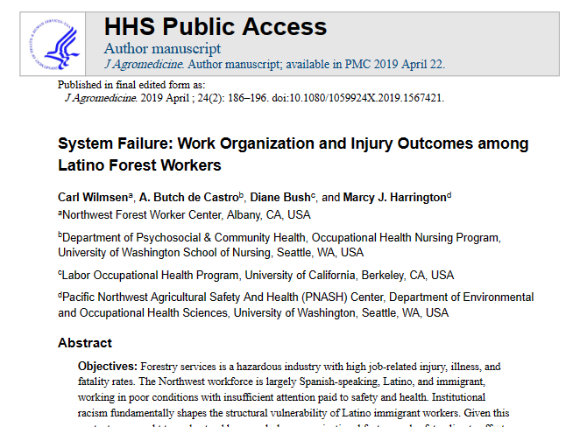
https://stacks.cdc.gov/view/cdc/77742

Slide 27
NW Forestry Top Injury & Illness (Qualitative)
LOGGING
Traumatic injuries
Back, muscle, or joint (MSDs)
Poor sleep
Overexertion
Hearing loss
FORESTRY SERVICES
Cuts / lacerations
Back strain
Fractures
Bruises
Heat illness
Pesticide exposure/illness
Notes:
Results showed hazards from stakeholder viewpoints corresponded well with data from workers compensation injury data and studies previous conducted in Oregon, Idaho and Washington states.
It is important to frame these needs in the forestry industry’s strengths. This is our opportunity to build on. It is an industry currently providing greater pay and job opportunity than many other rural jobs. Our studies showed the workforce often in good physical health, although there are concerns over fitness for machine operators and aging loggers. Also, there was signs of good job satisfaction in recent logger interviews (English speaking).

Slide 28
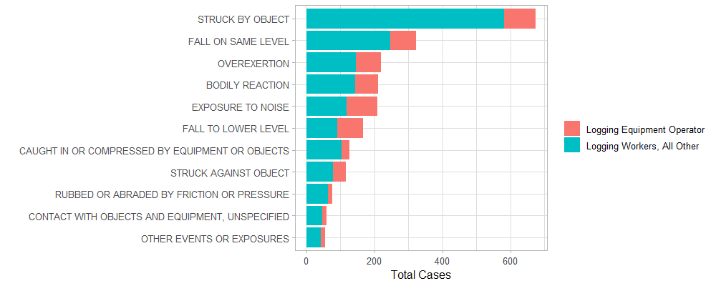
EVENT – Accepted Claims, Logging, WA
Source: WA Dept. of Labor and Industries (LNI) 2016
PACIFIC NORTHWEST AGRICULTURAL SAFETY AND HEALTH CENTER
Notes:
As close a view as we have to the cause.
Often we turn to interviews to identify what is missing form data. In-turn, data can point to what is missing from interviews. What missing from what we can learn from standard statistics? Does not nec. Identify the root cause of accidents and does not not tell the whole story – these details will direct us to opportunities for solutions. Example – eg, heat illness.

Slide 29
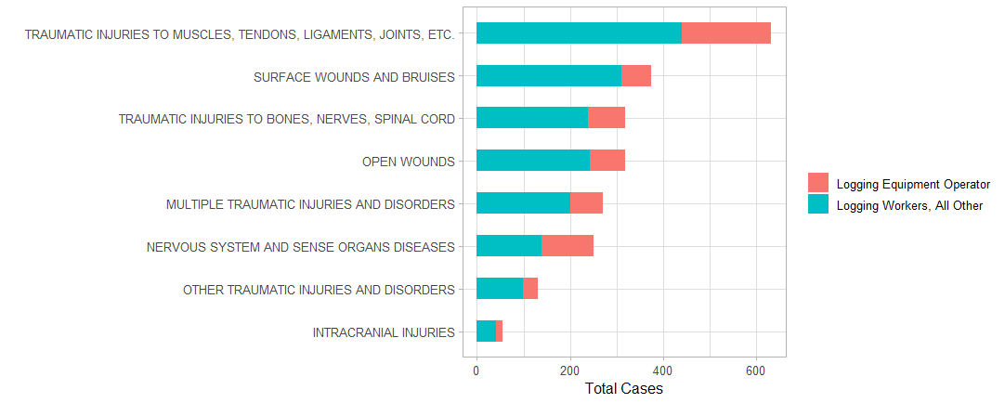
NATURE – Accepted Claims, Logging, WA
Source: WA Dept. of Labor and Industries, 2016
PACIFIC NORTHWEST AGRICULTURAL SAFETY AND HEALTH CENTER

Slide 30
Forestry Injury Root Cause & Priorities
NEAR-TERM
Safety Needs work pace, long hours w/ few breaks, accident investigation/record keeping, landing zones and roads (logging), location awareness, production pressure
Training Needs - fatigue and sleep, danger trees, fitness, pesticide edu for handlers, new-worker training, supervisor training, Spanish-language training
LONG-TERM
Research Directions - automation/robotics vs. boots on the ground, location awareness systems, practices/equipment for diff. environments (eg, salvage logging, steep, slippery), logger-directed practical solutions
Industry Directions - increased mechanization, long-term contracts, benefits packages (insurance, retirement), training certifications, safety leadership (top-down)

Slide 31

New Directions

Slide 32
NW FORESTRY SAFETY WORKING GROUP
2023 - 2027
Ernesto Alvarado, Professor, UW School of Forestry
Steve Barham, Safety Specialist, Associated Contract Loggers of Idaho
Francisca Belart, Extension Specialist, OSU School of Forestry
Edward Boulch, Manger, Logging Safety Initiative, Wash. Dept. of Labor & Industries
Jacob Delbridge, Policy Advisory, Wash. State Dept. of Natural Resources
Jim Gahlsdorf, President, Gahlsdorf Logging, Oregon
David Grim, Safety Manager, Associated Oregon Loggers
Andy Perleberg, Extension Forester, Washington State University
Carl Wilmsen, Research Associate, Lomakatsi Restoration Project/NW Forest Worker Center
PNASH: Marcy Harrington, John Garland, Eddie Kasner, Rob Keefe
PACIFIC NORTHWEST AGRICULTURAL SAFETY AND HEALTH CENTER

Slide 33
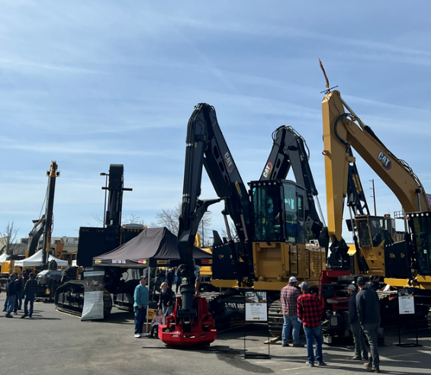
YOUR FEEDBACK
What priorities do you think are missing?
What is our best opportunity to make a difference?
What are the gaps in the research?

Slide 34


THANK YOU
Marcy Harrington, marcyw@uw.edu
John Garland, johngarland49@gmail.com
Eddie Kasner, ejkasner@uw.edu
Notes:
EXAMPLE USE OF THANK YOU SLIDE

